Slide 1

Bash scripting

Slide 2

Definition
Bash (Bourne Again SHell) is a command processor that typically runs in a text window where the user types commands that cause actions.

Slide 3
Purpose
Bash scripting is a great way to automate different types of tasks in a system. Developers can avoid doing repetitive tasks using bash scripting.
Bash scripting supports variables, conditional statements, and loops just like programming languages.

Slide 4
Key Features of Bash Shell Scripting
Interactivity: Bash allows users to interact with the system in a command-line environment.
Scripting: Users can write scripts to automate tasks by combining multiple commands.
Variables: Store and manipulate data using variables.
Control Structures: Implement conditional statements and loops.
Functions: Encapsulate code for reusability.

Slide 5
Bash Shell
Advantages
Disadvantages
It is simple.
It helps to avoid doing repetitive tasks
Easy to use
Frequently performed tasks can be automated
A sequence of commands can be run as a single command.
Any mistake while writing can be costly.
A new process launched for almost every shell command executed
Slow execution speed
Compatibility problems between different platforms

Slide 6

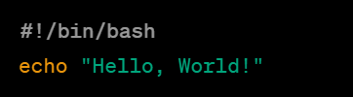


How to Write Bash Scripts? How to Write Bash Scripts?
Create a file with the .sh extension.
Write down the bash scripts within it
Provide execution permission to it
Execute the file

Slide 7
General purpose commands
S. No | Command | Description | Example
1 | ls | List files and directories in the current directory. | ls
2 | cd | Change the current working directory. | cd /path/to/directory
3 | pwd | Print the current working directory. | pwd
4 | cp | Copy files or directories. | cp file1.txt /path/to/destination
5 | mv | Move or rename files or directories. | mv file1.txt newfile.txt
6 | rm | Remove/delete files or directories. | rm file.txt

Slide 8
General purpose commands
S. No | Command | Description | Example
7 | mkdir | Create a new directory | mkdir new_directory
8 | rmdir | Remove an empty directory. | rmdir empty_directory
9 | touch | Create an empty file or update the timestamp of an existing file | touch new_file.txt
10 | cat | Display the contents of a file. | cat file.txt
11 | echo | Display a message or the value of a variable. | echo "Hello, World!"
12 | Grep | Search for a pattern in a file. | grep "pattern" file.txt

Slide 9
General purpose commands
S. No | Command | Description | Example
13 | find | Search for files and directories based on various criteria | find /path/to/search -name "*.txt”
14 | chmod | Change the permissions of a file or directory. | chmod +x script.sh
15 | chown | Change the owner of a file or directory | chown user:group file.txt
16 | ps | Display information about running processes. | ps aux
17 | kill | Terminate a process | kill PID
18 | df | Display information about disk space usage. | df -h

Slide 10
General purpose commands
S. No | Command | Description | Example
19 | du | Display the disk usage of files and directories. | du -h
20 | man | Display the manual (documentation) for a command. | man ls
21 | who | Displays all the users who have logged into the system currently. | who
22 | cal | display calendar | cal
23 | clear | clean up the terminal | clear
24 | history | get list of previous commands may be obtained | history

Slide 11


Slide 12
Which command is used to display the current directory in Linux? Which command is used to display the current directory in Linux?
a) ls
b) cd
c) pwd
d) dir

Slide 13
What command is used to list the contents of a directory in Linux?
a) ls
b) dir
c) list
d) show

Slide 14
To create a new directory in Linux, you would use the command:
a) mkdir
b) newdir
c) create
d) touch

Slide 15
What command is used to copy files or directories in Linux?
a) mv
b) copy
c) cp
d) xcopy

Slide 16
To remove a file in Linux, you would use the command:
a) delete
b) rm
c) del
d) erase

Slide 17
Which command is used to change the current user's password in Linux?
a) passwd
b) change
c) setpasswd
d) userpassword

Slide 18
The command to display the last few lines of a text file in Linux is:
a) head
b) tail
c) cat
d) more

Slide 19
To navigate to the home directory of the current user in Linux, you would use the command:
a) cd /
b) cd ~
c) cd home
d) cd ..

Slide 20
Which command is used to find files in Linux based on their names?
a) locate
b) search
c) find
d) grep

Slide 21
The command to view the manual (help) for a specific command in Linux is:
a) man
b) help
c) info
d) view

Slide 22
Answers:
1.C | 2.A | 3.A | 4.C | 5.B
6.A | 7.B | 8.B | 9.C | 10.A

Slide 23
Redirection operators
S. No | Command | Description | Example
1 | > (Output Redirection) | Redirects standard output to a file, overwriting the file if it already exists. | command > output.txt
2 | >> (Append Output) | Redirects standard output to a file, appending the output to the end of the file if it already exists. | command >> output.txt
3 | < (Input Redirection) | Redirects standard input from a file instead of the keyboard | command < input.txt
4 | | (Pipe) | Connects the output of one command to the input of another, allowing the output of the first command to serve as input for the second. | command1 | command2
5 | 2> (Standard Error Redirection) | Redirects standard error output to a file | command 2> error.txt

Slide 24
Redirection operators
S. No | Command | Description | Example
6 | 2>> (Append Standard Error) | Redirects standard error output to a file, appending to the end of the file. | command 2>> error.txt
7 | &> or >& (Redirect Standard Output and Standard Error) | Redirects both standard output and standard error to a file. | command &> output_and_error.txt
8 | <() (Process Substitution) | Allows the output of a command to be used as a file in another command. | diff <(command1) <(command2)
9 | >() (Process Substitution for Writing) | Allows the output of a command to be used as a file to write to. | command > >(tee output.txt)
10 | << (Here Document) | Allows input to be taken from the lines following the operator until a specified delimiter is encountered. | cat << EOF This is a multi-line input. It ends at the delimiter EOF. EOF

Slide 26
Which redirection operator is used to redirect standard output to a file in Linux?
a) >
b) <
c) >>
d) |

Slide 27
What does the 2> redirection operator do in Linux?
a) Redirects standard output to a file.
b) Redirects standard error to a file.
c) Appends standard output to a file.
d) Creates a new file.

Slide 28
To append the output of a command to an existing file in Linux, you would use the redirection operator:
a) >
b) >>
c) <
d) |

Slide 29
The command command1 | command2 in Linux uses which type of redirection?
a) Input Redirection
b) Output Redirection
c) Pipe Redirection
d) Error Redirection

Slide 30
What does the &> redirection operator do in Linux?
a) Redirects standard output and standard error to a file.
b) Redirects standard input from a file.
c) Redirects standard output to a file.
d) Redirects standard error to the screen.

Slide 31
answers

Slide 32

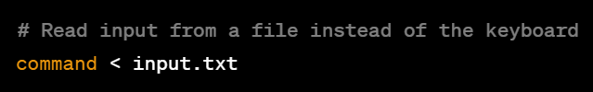
Stdin (standard input)
It stands for standard input, and is used for taking text as an input.
Linux assigns unique values 0 = stdin
By default, STDIN is connected to the keyboard, and commands read input from the keyboard unless redirected.

Slide 33


STDOUT (standard output)
STDOUT is the standard output stream.
By default, STDOUT is connected to the terminal, and commands display their output on the terminal.
File Descriptor: 1

Slide 34


Stderr (standard error)
STDERR is the standard error stream
It is used to output error messages and diagnostic information separate from the regular output.
Like STDOUT, STDERR is connected to the terminal by default.

Slide 36
Which file descriptor is associated with Standard Input in Linux?
a) STDIN
b) STDOUT
c) STDERR
d) STDFILE

Slide 37
What is the default file descriptor for Standard Output in Linux?
a) STDIN
b) STDOUT
c) STDERR
d) STDFILE

Slide 38
In a Linux command, which symbol is used to represent Standard Output?
a) >
b) <
c) &
d) |

Slide 39
Which file descriptor is used for error messages in Linux?
a) STDIN
b) STDOUT
c) STDERR
d) STDFILE

Slide 40
What does the symbol 2> signify in a Linux command?
a) Redirects Standard Output to a file.
b) Redirects Standard Input from a file.
c) Redirects Standard Error to a file.
d) Redirects both Standard Output and Standard Error to a file.

Slide 41
Answers:

Slide 42

Echo command
The echo command in Linux is a built-in command that allows users to display lines of text or strings that are passed as arguments.
OPTION: This is optional and can modify the behavior of the echo command.
STRING: The text or message that you want to display.

Slide 43



Examples
1. Print a Simple Message
2. Print a variable
3. Display without newline
4. Escape Characters

Slide 44


Bash variables
Data is stored at a particular memory address and then
Variables let you store, read, access, and manipulate data. It can be accessed as well as modified when required
Syntax -
Example -

Slide 45


Accessing Variable Value
Concatenating Variables:

Slide 46



String Variables
Numeric Variables
Boolean Variables

Slide 47


Special variables
Positional Parameters - $0, $1, $2, ...: Represent the script or command name, and the command-line arguments.
Environment Variables: $HOME, $USER, $PATH, etc.: Represent system or user-specific information

Slide 48
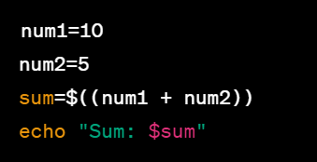
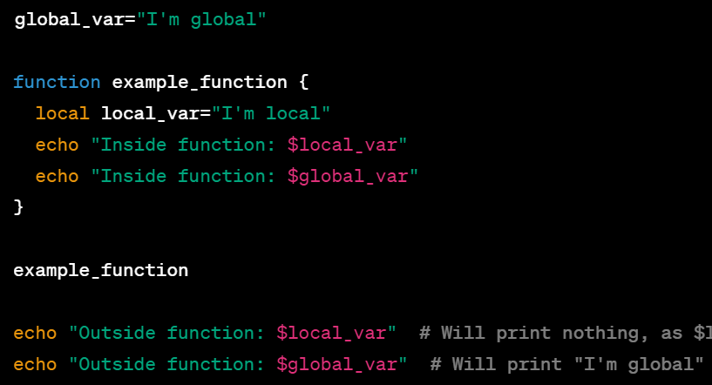
Performing Arithmetic
Local and Global Scope

Slide 50
In programming, what is the process of combining two or more strings into a single string called?
a) Concatenating
b) Merging
c) Joining
d) Appending

Slide 51
Which operator is commonly used for concatenating strings in many programming languages?
a) +
b) *
c) /
d) -

Slide 52
What is the result of concatenating the strings "Hello" and "World"?
a) "HelloWorld"
b) "Hello World"
c) "Hello,World"
d) "Hello-World"

Slide 53
In programming, what data type is typically used to represent whole numbers (integers)?
a) String
b) Numeric
c) Boolean
d) Character

Slide 54
Which of the following is a boolean operator often used for logical comparisons?
a) &
b) |
c) !
d) ^

Slide 55
ANSWERS:

Slide 56
Text Processing Commands Overview
Text Processing Commands:
grep, cut, awk.
Essential tools for manipulating and extracting information from text data.
Objective:
Understand the purpose and usage of these commands in Linux.

Slide 57


grep - Global Regular Expression Print
Definition:
grep searches for patterns in text files and displays matching lines.
Basic Syntax:
Example:

Slide 58


cut - Removing Sections from Each Line
Definition:
cut removes sections from each line of a file.
Basic Syntax:
Example:

Slide 59


awk - Text and Pattern Processing
Definition:
awk is a versatile text-processing tool for pattern scanning and processing.
Basic Syntax:
Example:

Slide 60

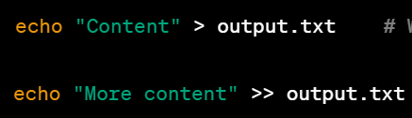
Input and Output Redirection
Redirection Operators:
<: Redirects input from a file.
>: Redirects output to a file.
>>: Appends output to a file.

Slide 61
Command Chaining
Definition:
Command chaining involves executing multiple commands sequentially or conditionally.
Operators:
;: Execute commands sequentially.
&&: Execute the second command only if the first one succeeds.
||: Execute the second command only if the first one fails.

Slide 62

Example: Sequential Command Chaining (;)
Explanation:
mkdir my_directory: Creates a new directory named "my_directory."
cd my_directory: Changes the current working directory to "my_directory."
ls -l: Lists the contents of the current directory in a detailed format.
Result:
These commands will be executed one after the other, regardless of whether the previous command succeeds or fails.

Slide 63
Conditional Command Chaining (&&)
Explanation:
gcc my_program.c -o my_program: Compiles a C program named "my_program.c" and creates an executable named "my_program."
./my_program: Executes the compiled program.
Result:
The second command (./my_program) will only execute if the compilation (gcc) is successful. If the compilation fails, the second command won't be executed.

Slide 64
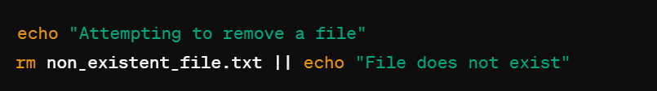
Conditional Command Chaining (||)
Explanation:
The rm non_existent_file.txt command attempts to remove a file (non_existent_file.txt).
If the file doesn't exist, the rm command will fail, and the echo "File does not exist" command after || will be executed.
Result:
The second command (./my_program) will only execute if the compilation (gcc) is successful. If the compilation fails, the second command won't be executed.

Slide 66
Which command is used for pattern matching and searching in a text file in Linux?
a) cut
b) awk
c) grep
d) sed

Slide 67
What does the cut command do in Linux?
a) Extracts specific columns from a text file
b) Searches for patterns in a text file
c) Replaces text in a file
d) Concatenates multiple files

Slide 68
What is the primary purpose of the awk command in Linux?
a) Pattern matching and searching
b) Text extraction based on delimiters
c) Replacing text in a file
d) Sorting lines in a file

Slide 69
To redirect the output of a command to a file in Linux, which symbol is commonly used?
a) >
b) <
c) >>
d) &>

Slide 70
In Linux, what is command chaining used for?
a) Concatenating text files
b) Running multiple commands sequentially
c) Extracting specific columns from a text file
d) Searching for patterns in a file

Slide 71
ANSWERS:

Slide 72
Scheduling Jobs with crontab
Definition:
crontab is a time-based job scheduler in Unix-like operating systems.
Syntax:

Slide 73





Examples
Example 1: Run a Command Every Minute
Example 2: Schedule a Daily Backup at 2 AM
Example 3: Schedule a Weekly Task on Mondays
Example 4: Run a Script on the 15th of Every Month
Example 5: Run a Command Every Hour

